Slide 1

PINN Papers Summary
Jiwon Kang
MS-PhD Program of Mechanical Engineering
Seoul National University, South Korea

Slide 2
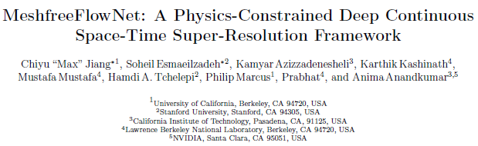
1. FlowNet
2. GOALS
2. cGAN-PID

Slide 3
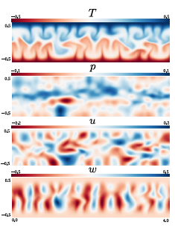
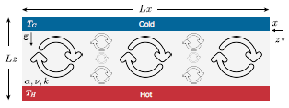
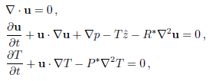
Main Idea
Rayleigh Benard convection instability problem
1. FlowNet
2. GOALS
2. cGAN-PID
Get Temperature, Pressure, 2 velocity components u, w
Typical solution

Slide 4
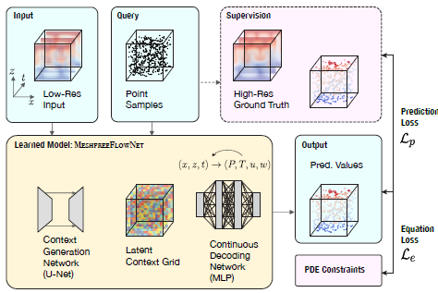
Methodology
Mesh free Flow-Net
1. FlowNet
calculate LR data with a PDE solver
2. cGAN-PID
U-Net generate latent context grid
(latent context vectors at each grid)
(* Just like in GAN methods)
MLP generate physical output
(T, P, u, w for grid points)
Trilinear interpolation
to get physical output
(T, P, u, w) for given query points

Slide 5
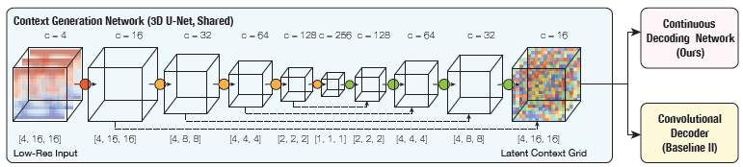
Methodology
Context generation network (1st part)
1. FlowNet
2. cGAN-PID
LR
Latent context grid
(contain 16 latent items)
Dataset
3-dimensional (x, z, t)
Network structure
3D variant of the U-Net architecture
Replace the 2D convolutions with 3D
Use residual structural (dotted arrows)
Metrics
NMSE, R2 score for 9 physical quantities
Physical quantities function of T, P, u, w

Slide 6
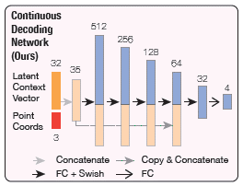
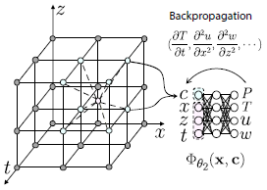
Methodology
Continuous decoding network (2nd part)
1. FlowNet
2. cGAN-PID
Latent context grid
(contain 16 latent items)
Discrete context grid
(contain 4 items: T, P, u, w)
MLP
Continuous context grid
(contain 4 items: T, P, u, w)
Query points
(manual selection)
Interpolation

Slide 7


Methodology
Loss Function
1. FlowNet
Predictions
2. cGAN-PID
Prediction Loss = Pixel wise Loss
Equation Loss = Physics Loss
Total Loss

Slide 8
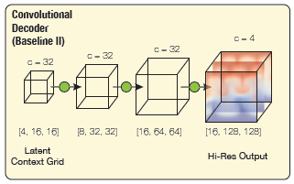
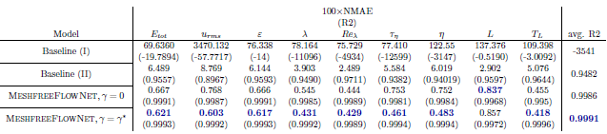
Experiments
1. Mesh free Flow-Net vs Baseline models
1. FlowNet
Baseline 1: pure interpolation
2. cGAN-PID
Baseline 2: pure decoder (no interpolation/ FC layer)
Proposed method
encoding/decoding + FC + interpolation

Slide 9
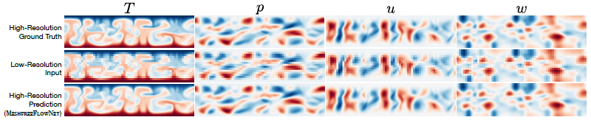

Experiments
2. Prediction Loss vs Equation Loss
1. FlowNet
Varying $γ$ in the total loss
Use of both shows the best performance: optimum 0.05
2. cGAN-PID
3. Evaluation on unseen physical initial/boundary conditions
- Model can generalize well
- Improvements by training on diverse conditions
4. Scalability
- Huge improvements with multi GPUs

Slide 10
Pros and Cons
Pros
1. FlowNet
Faster computation compared to conventional PDE solver
Compute values in continuous domains
2. cGAN-PID
Cons
Experiments only on simulations
Hard to find the optimum architecture

Slide 11
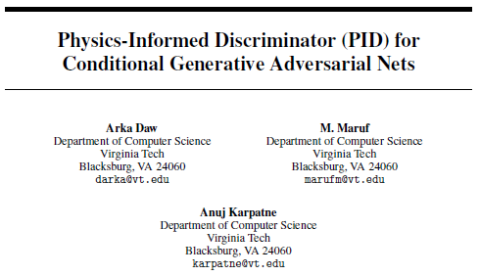
1. FlowNet
2. GOALS
2. cGAN-PID

Slide 12
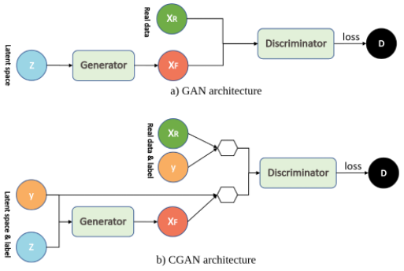
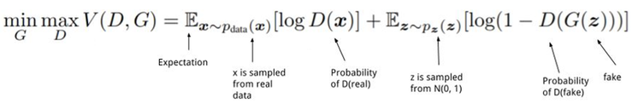
Main Idea
Physics Informed conditional GAN (cGAN)
1. FlowNet
2. GOALS
2. cGAN-PID
Problem formulation of conventional GAN
Problem formulation of conditional GAN
Conditional GAN Architecture
additional condition y imposed
Use Physics constraints
as conditions in cGAN

Slide 13
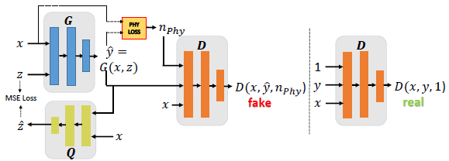
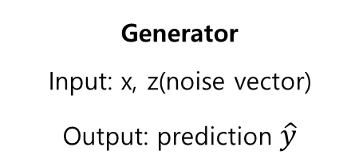
Methodology
1. FlowNet
2. cGAN-PID
Physics Loss
Generator
Input: x, z(noise vector)
Output: prediction $\hat{y}$
Additional Network Q
likelihood score of generated sample
1(same to real data) if physics loss is 0
0(100% fake data) if physics loss is infinite
stabilize the training procedure

Slide 14
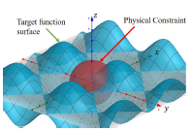
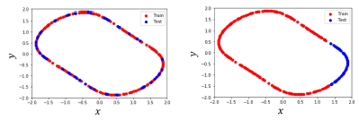
Experiment
1. Synthetic toy dataset
1. FlowNet
2. cGAN-PID
2D wave: Target Function
In distribution
Out of distribution
x, y: 10000 random points between the interval [-2, 2]
Select points near intersection of the 2 curves
with tolerance value of 0.00001
Sphere: Physical Constraint
300 (x, y) points for certain z value
Input: (x, y) -> Output z
2 Experiments: Train/Test in distribution or out of distribution

Slide 15

Experiment
2. Collision Experiment dataset (Simulation dataset from another paper)
1. FlowNet
input x: Speed/Mass/Distance of 2 objects
D
2. cGAN-PID
Output: speed after collision
Apply Physics Loss from energy and momentum equations
Comparison with 3 other baselines
Standard cGAN
Standard cGAN + physics loss
MLP + physics loss
cGAN + physics loss + modified discriminator + network Q (proposed)
3. Metrics and Comparison
Metrics
RMSE
Mean physical inconsistency

Slide 16
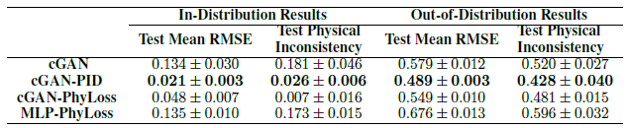
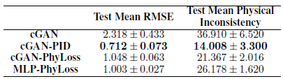
Results
1. Synthetic toy dataset
1. FlowNet
2. cGAN-PID
2. Collision Experiment dataset (Simulation dataset from another paper)

Slide 17
Pros and Cons
Pros
1. FlowNet
Show the potential of cGAN in PINN applications
Similar to Super resolution methods -> might be applicable on super resolution missions
2. cGAN-PID
Cons
Conducted experiments on only mathematical datasets

